Slide 1
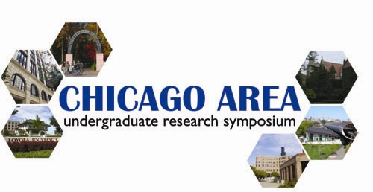
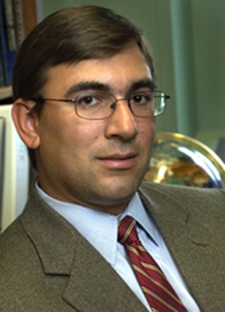






Saturday, April 1, 2006
9 am - 5 pm
Chicago Cultural Center
78 East Washington St.
CHICAGO
Over 100 scientific research presentation by undergraduates
representing six outstanding area universities!
1:00 p.m. Guest Research Lecture
Living Devices: Integrating Cells with Electronics
Milan Mrksich, Ph.D.
Department of Chemistry, University of Chicago
GUEST WELCOME!
For detailed information and to view the complete schedule of events, please visit:
WWW.CAURS.COM

